Slide 1
Internship Project (Review 0) Cloud SDLC in Broadridge
Puneet Jain
BL.EN.P2DSC20031
Mentor
Mr. Udaya Goteti
(Technology Architect)

Slide 2
Contents
About Broadridge
About Team
What is Cloud ?
AWS
SDLC
DevOps
Introduction to Git, Jenkins, Docker, Nexus, Chef & Terraform

Slide 3
About Broadridge
Broadridge, a global Fintech leader with $5 billion in revenues, provides the critical infrastructure that powers investing, corporate governance and communications to enable better financial lives. We deliver technology-driven solutions that drive digital transformation for our clients and help them get ahead of today’s challenges to capitalize on what’s next.

Slide 4
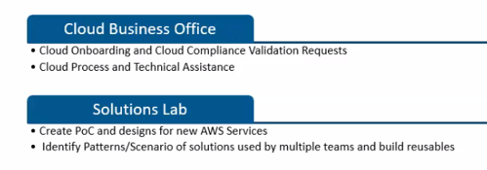
About Team

Slide 5

WHAT IS CLOUD?

Slide 6
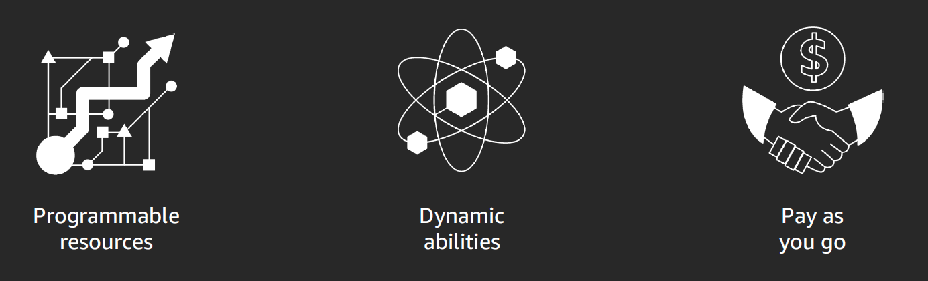
What is the cloud?
Cloud computing enables you to stop thinking of your infrastructure as hardware, and instead think of it (and use it) as software.

Slide 7
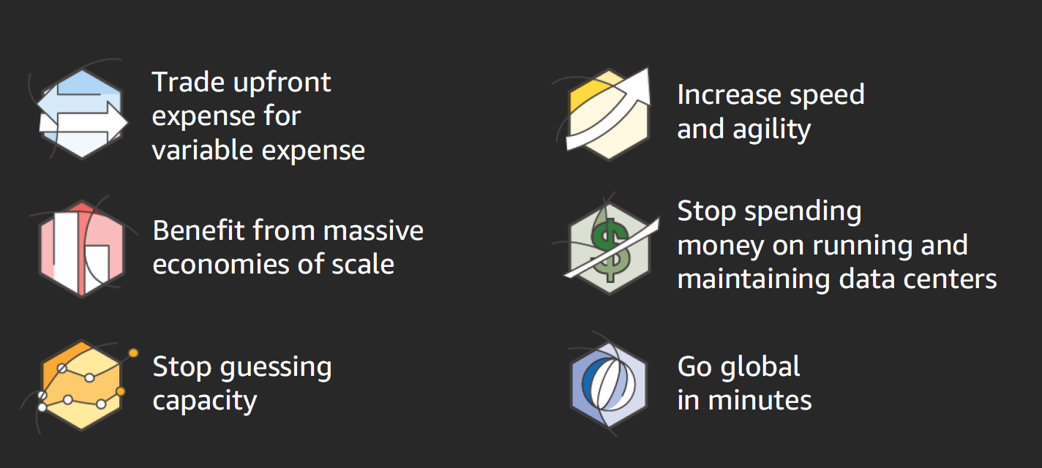
Six advantages of cloud computing

Slide 8
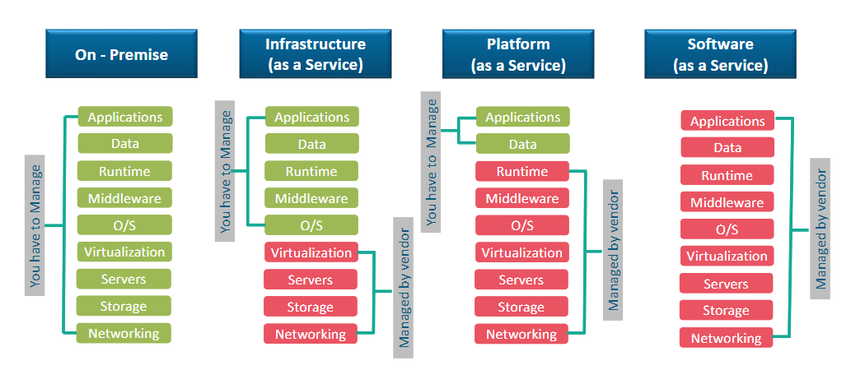
Cloud Services Model
There are 4 main types of cloud computing: private clouds, public clouds, hybrid clouds, and multiclouds.
There are also 3 main types of cloud computing services: Infrastructure-as-a-Service (IaaS), Platforms-as-a-Service (PaaS), and Software-as-a-Service (SaaS).
But On-Premise is Private Cloud Service i.e., within organization.

Slide 9
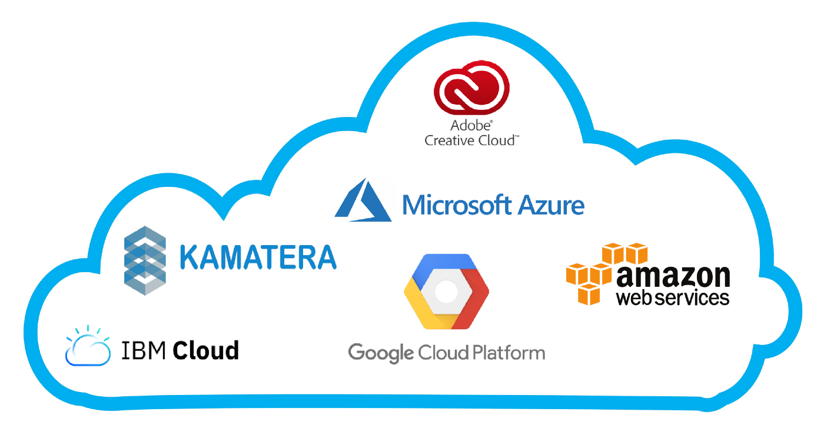
Cloud Computing Service Providers
Due to its hassle-free method of reaching countless IT resources, cloud computing is spreading like wildfire.
Everyone is trying to embrace cloud computing for a better performance of a business, efficiency, and other benefits.
Below diagram shows 6 best cloud computing service providers.

Slide 10
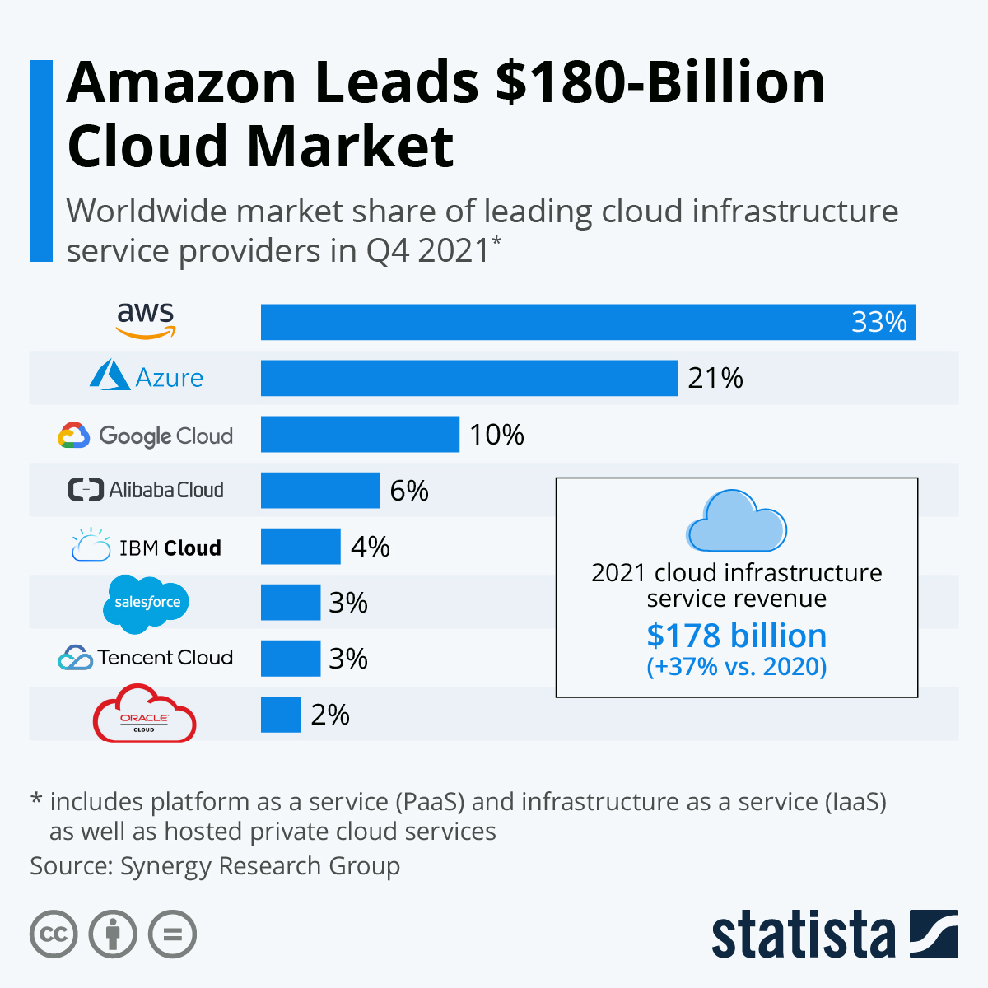
Cloud Market Leader

Slide 11
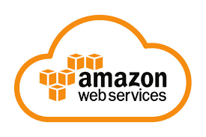
AWS

Slide 12
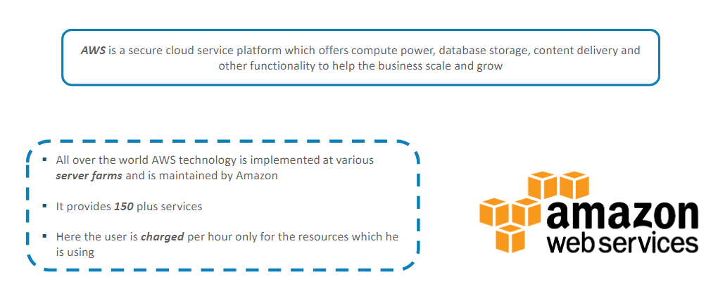
AWS (Amazon Web Service)

Slide 13
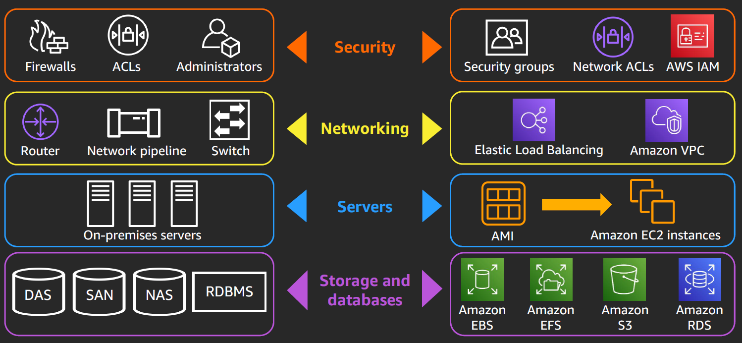
AWS core infrastructure and services

Slide 14
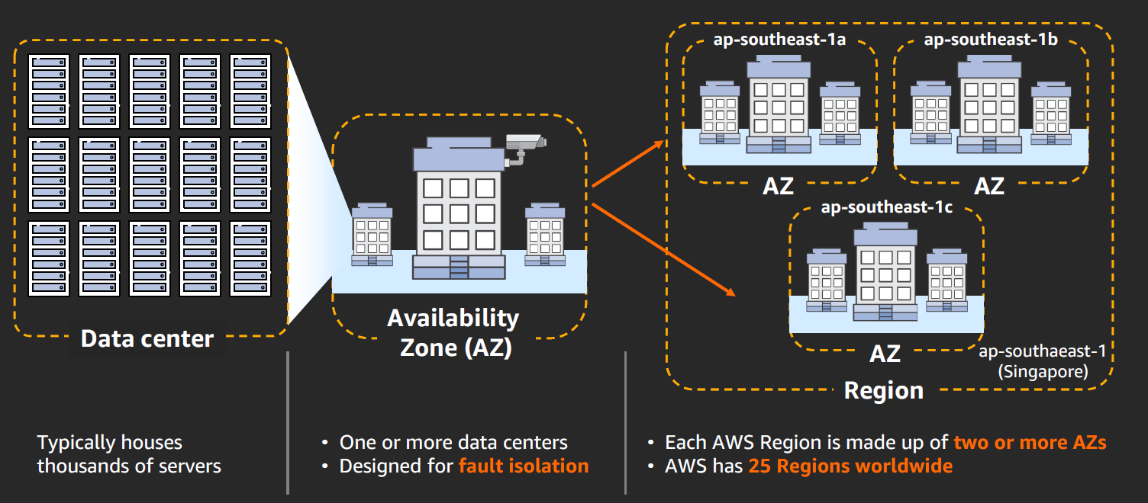
AWS global infrastructure

Slide 15
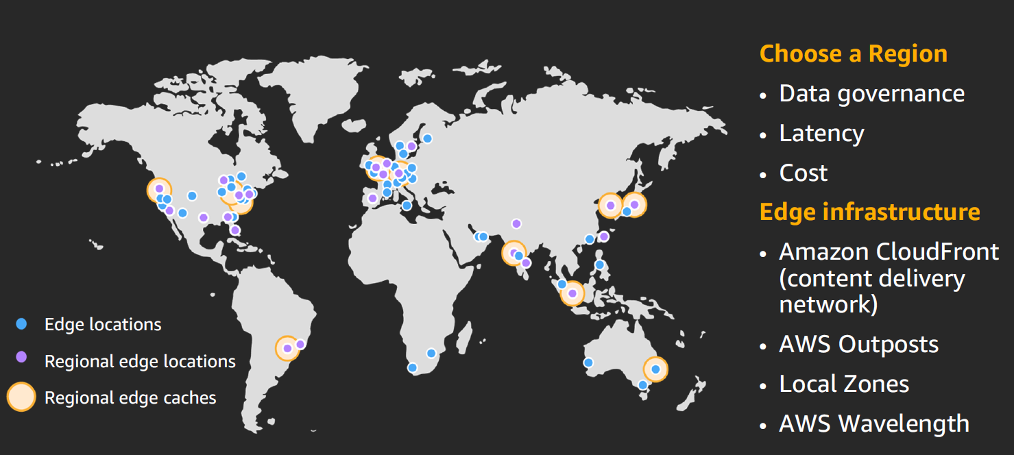
AWS global infrastructure: Current Regions

Slide 16
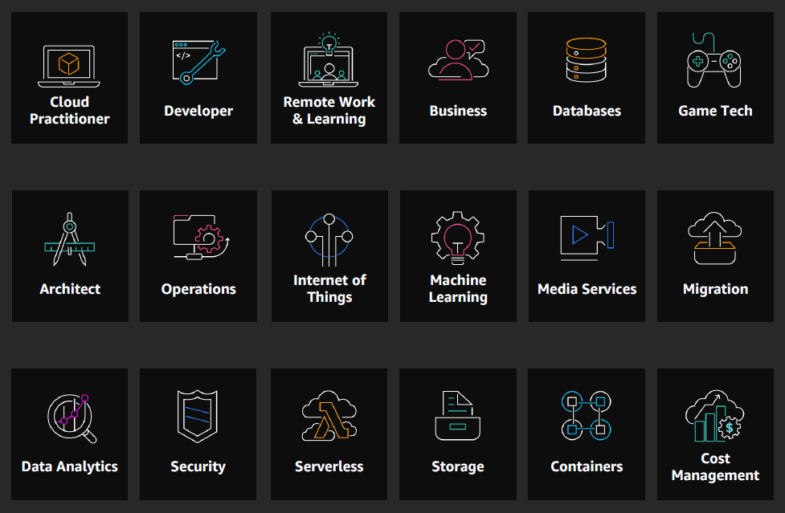
AWS ramp up

Slide 17
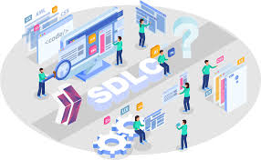
SDLC

Slide 18
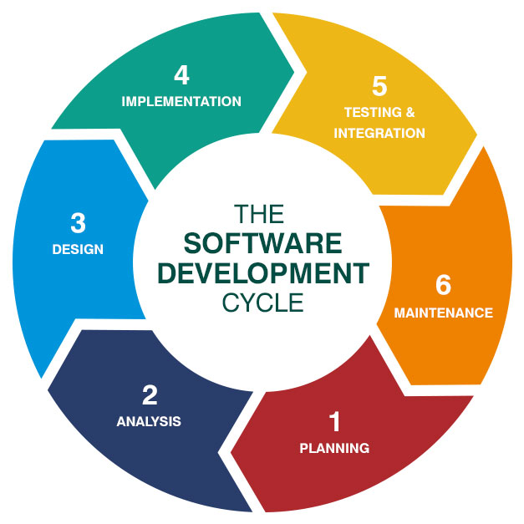
What is SDLC?
Software Development Life Cycle (SDLC) is a process used by the software industry to design, develop and test high quality software’s.

Slide 19
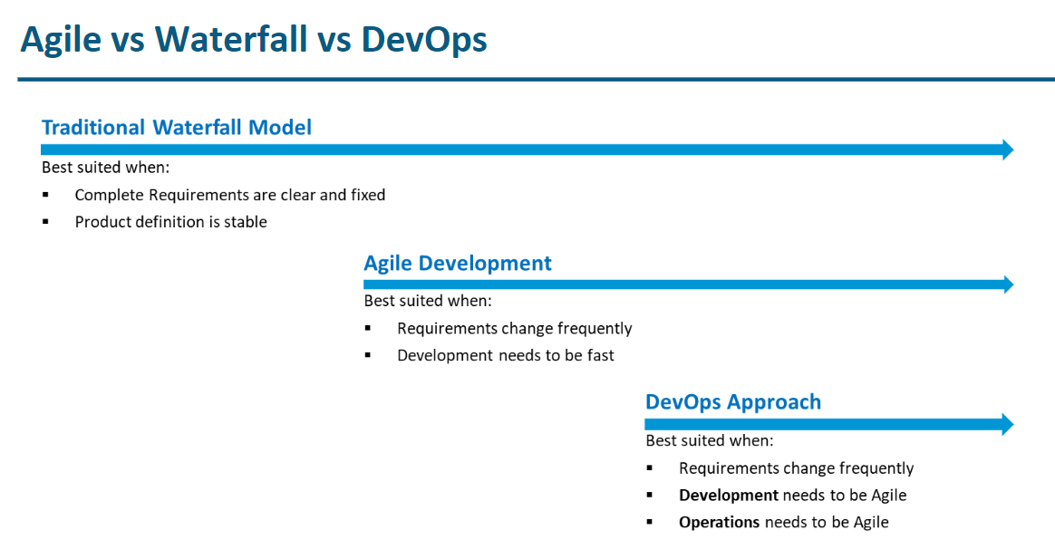
Understanding Agile & DevOps

Slide 20
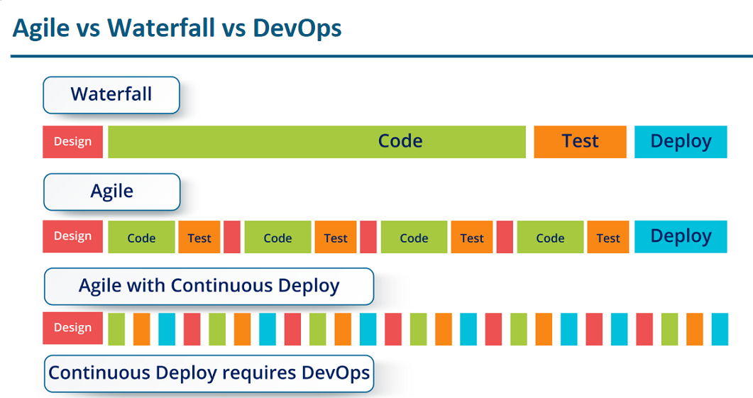

Slide 21
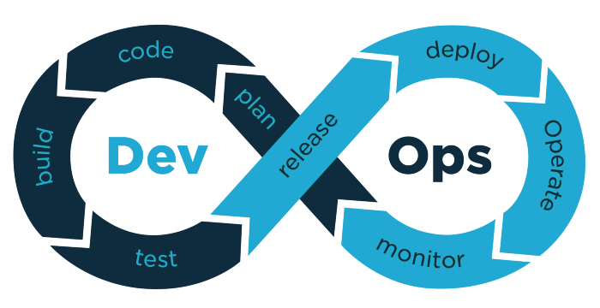
DevOps

Slide 22
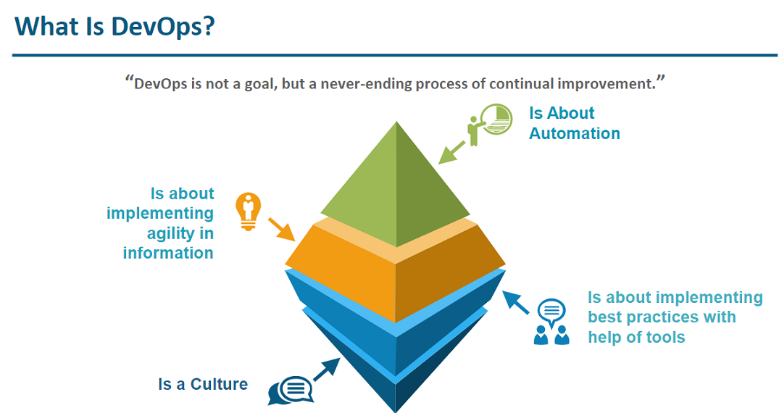
What is DevOps?

Slide 23
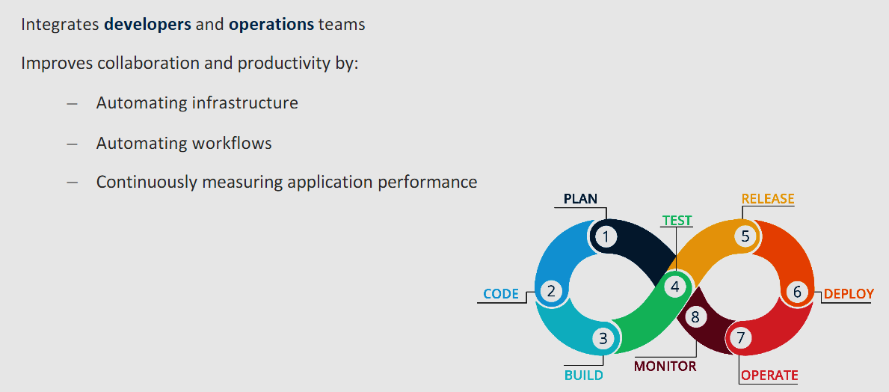
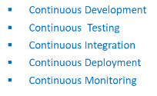
What Does DevOps Do??

Slide 24
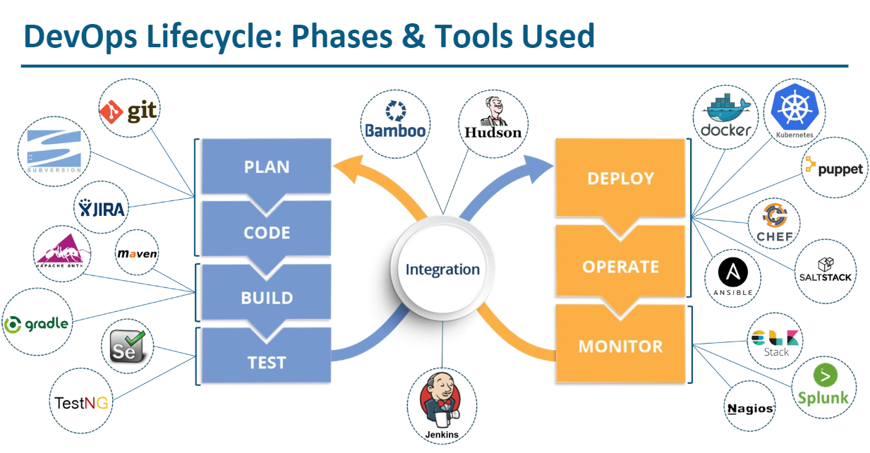
DevOps Lifecycle: Phases & Tool used

Slide 25
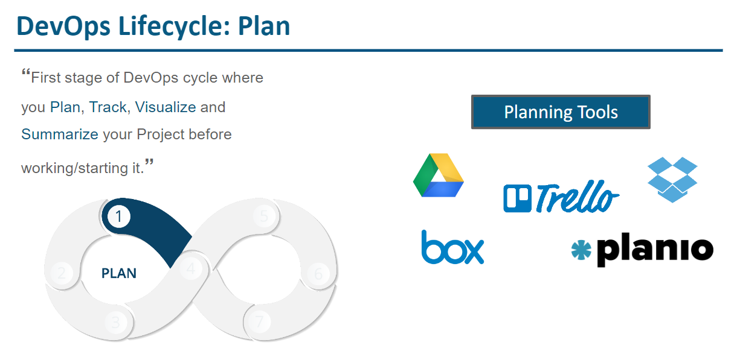

Slide 26
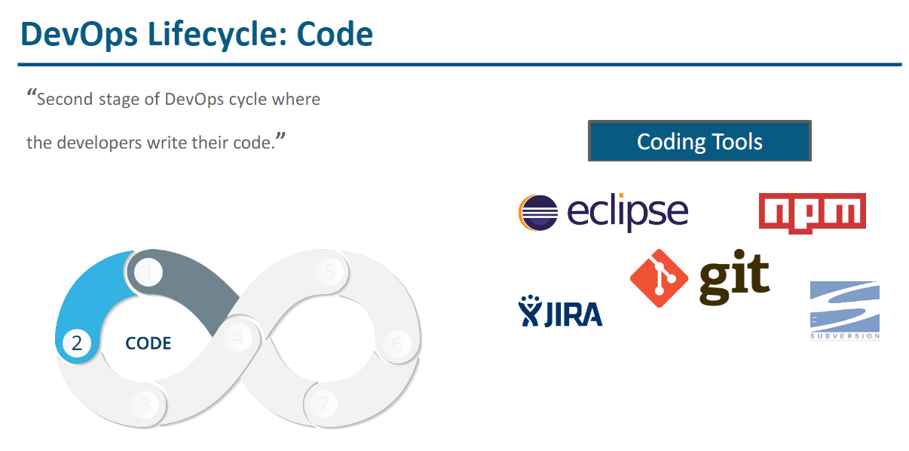

Slide 27
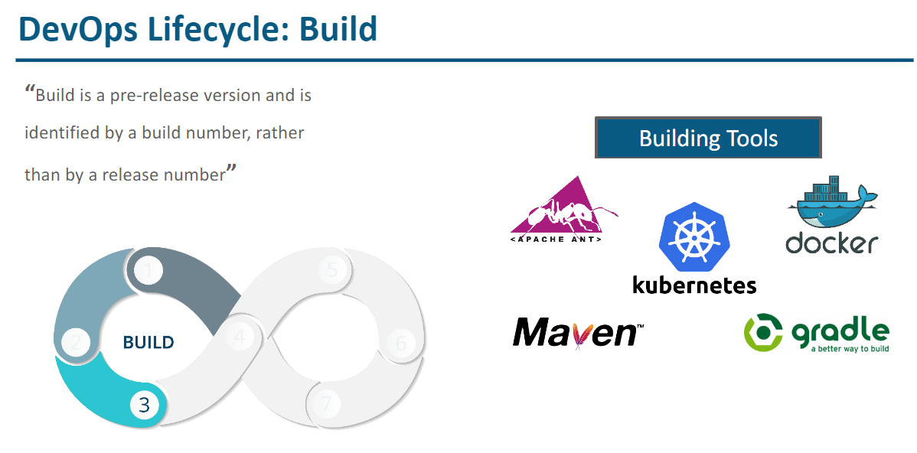

Slide 28
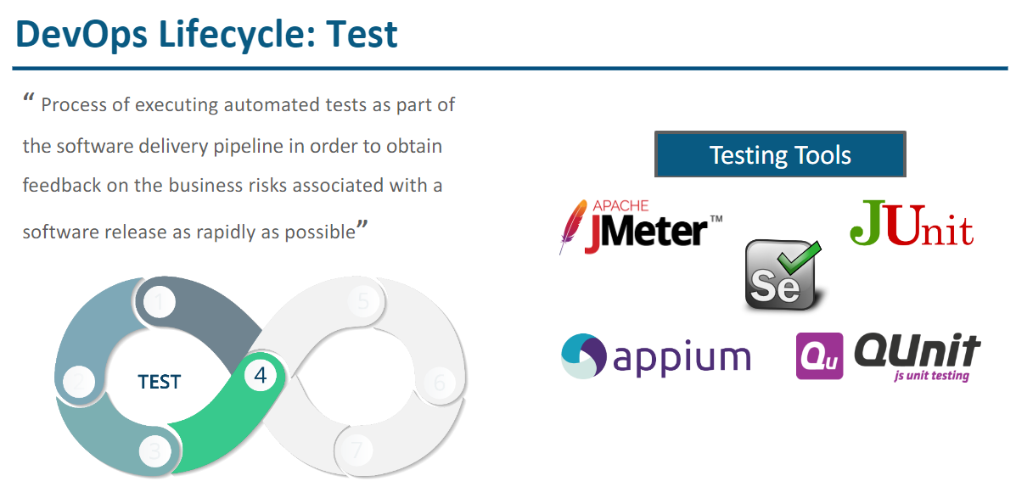

Slide 29
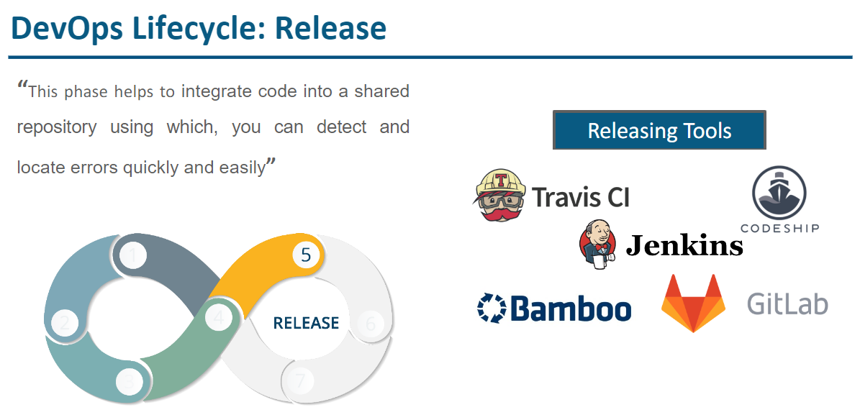

Slide 30
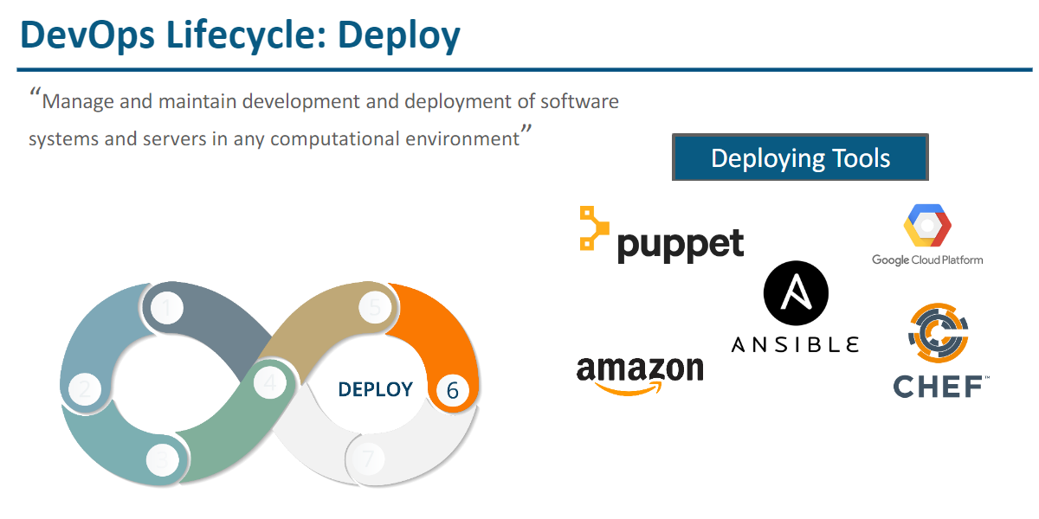

Slide 31
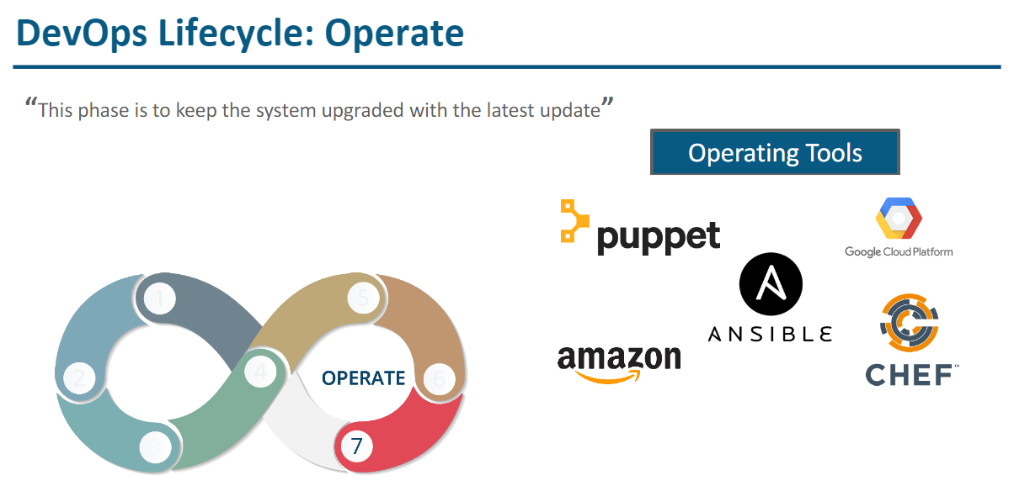

Slide 32
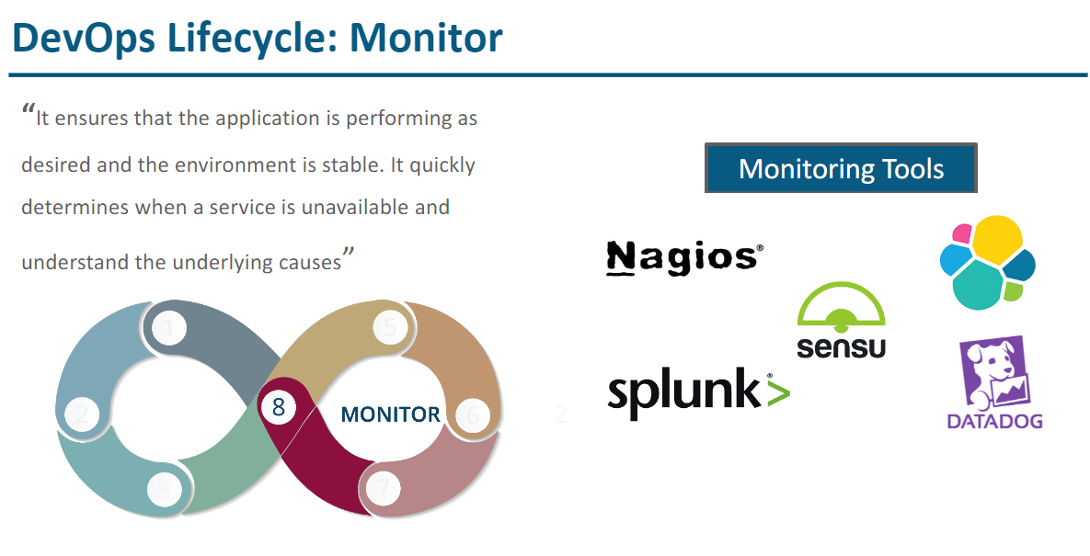

Slide 33
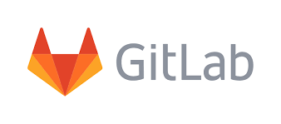

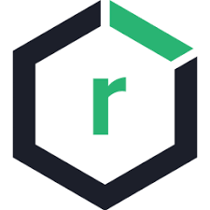

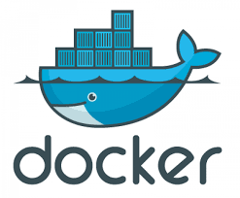
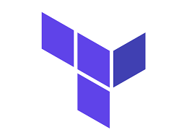
Introduction to Git, Jenkins, Docker, Nexus, Chef & Terraform

Slide 34
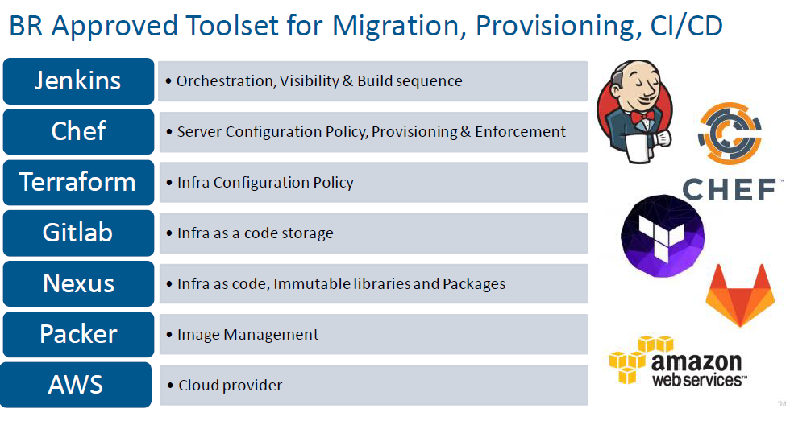
Tools Used

Slide 35
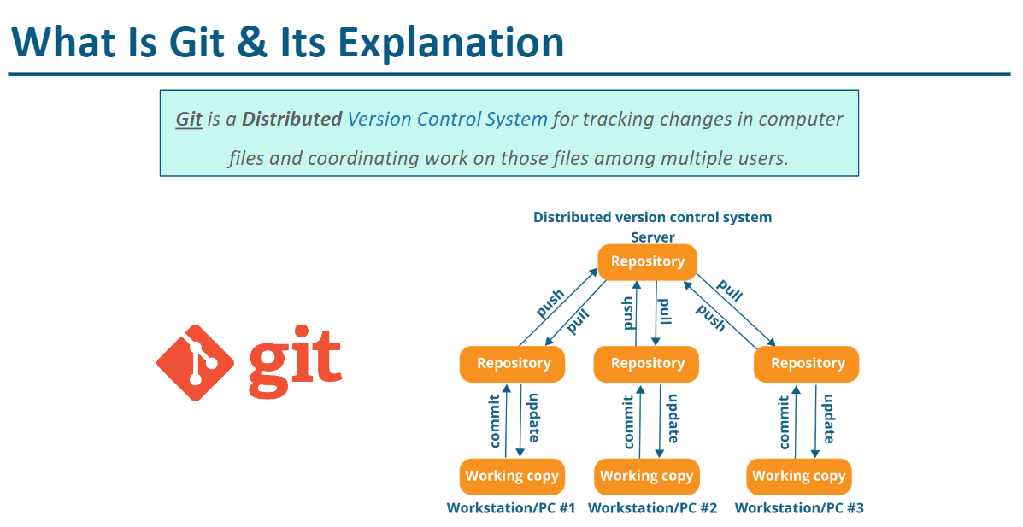
What is Git?

Slide 36
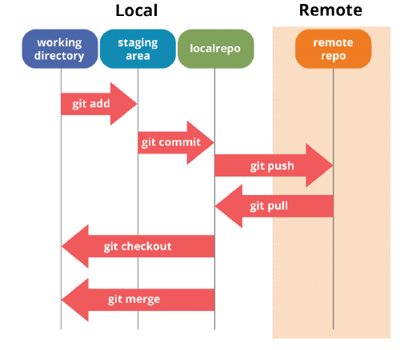
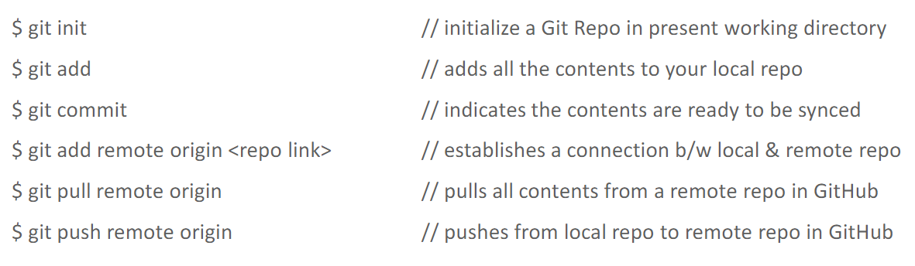

Slide 37
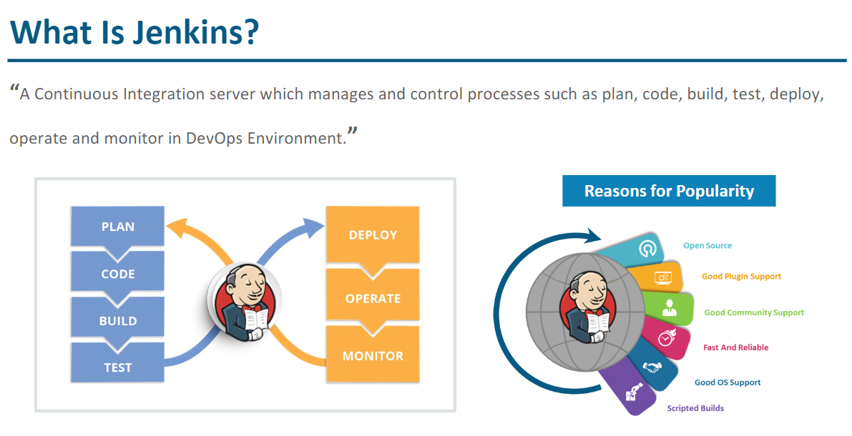
What is Jenkins?

Slide 38
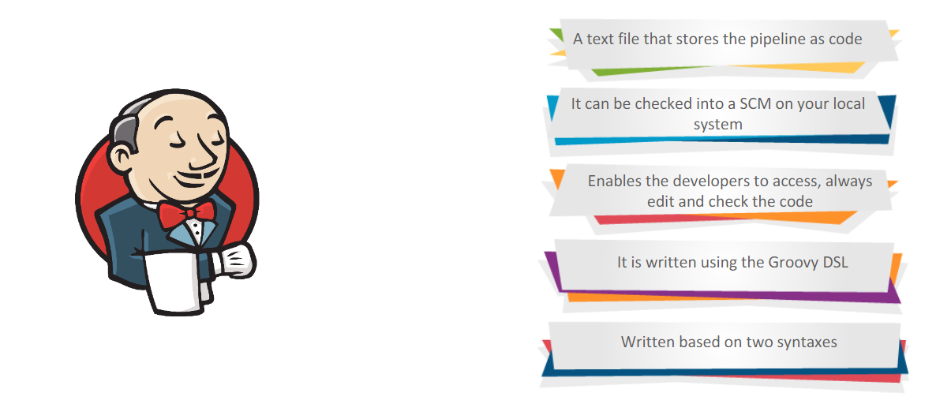
Jenkins is JenkinsFile?

Slide 39
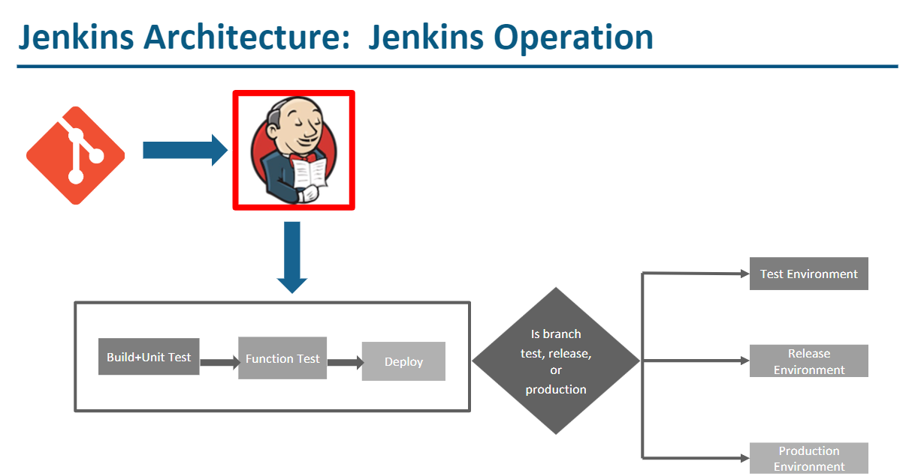

Slide 40
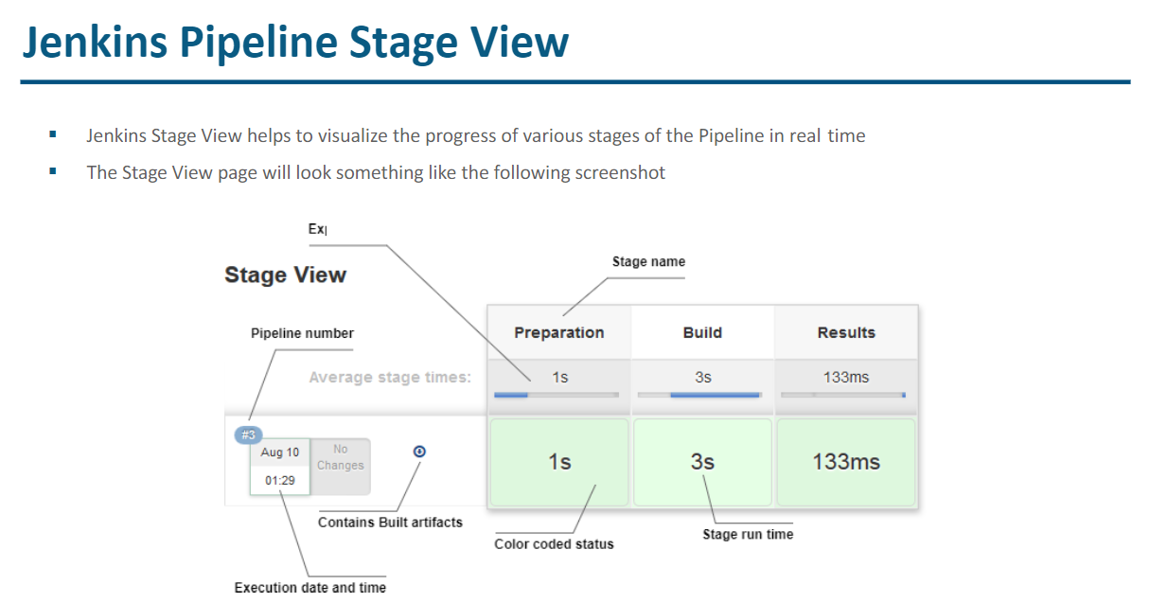

Slide 41
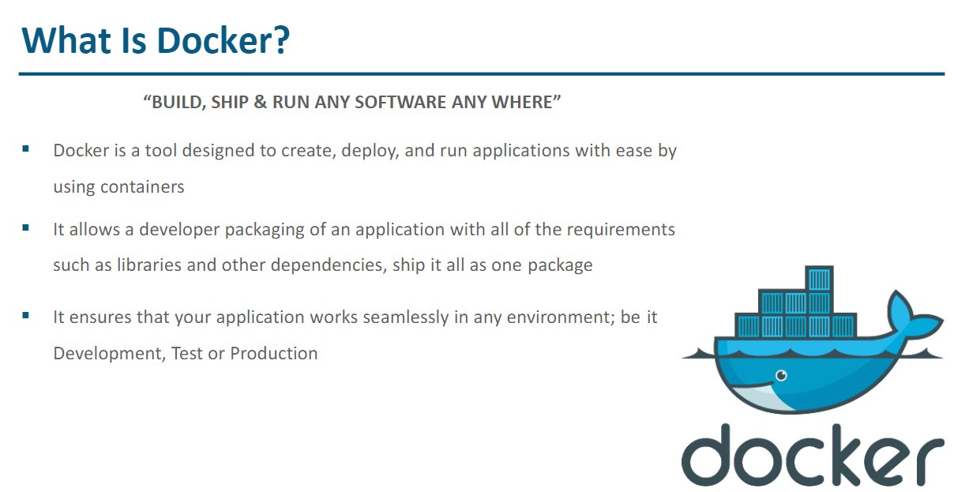
What is Docker

Slide 42
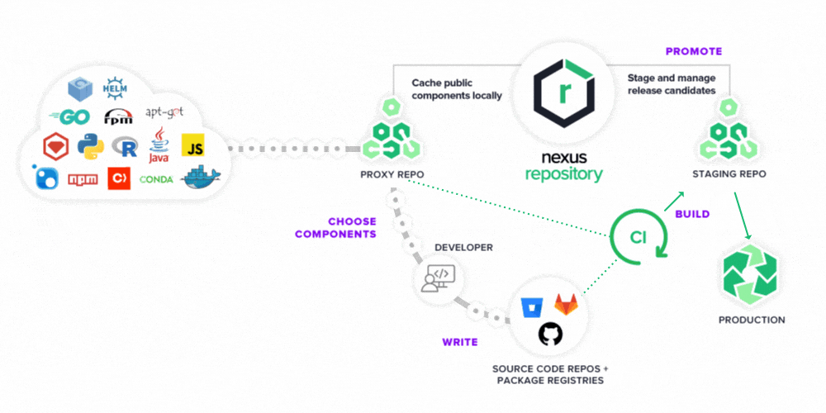
What is Nexus?
"Nexus is a repository manager. It allows you to proxy, collect, and manage your dependencies so that you are not constantly juggling a collection of JARs. It makes it easy to distribute your software. Internally, you configure your build to publish artifacts to Nexus and they then become available to other developers.

Slide 43

What is Chef?
Chef is a configuration management tool.
Define infrastructure as code.
Uses domain-specific language (DSL) based on Ruby
Follows Client-Server architecture.
Supports multiple platforms ( Linux, Microsoft Windows, FreeBSD, OS X, Solaris, AIX )
Identifies current state of the machine and maintains that state

Slide 44

What is Terraform?
Terraform is a tool for building, changing, and versioning infrastructure safely and efficiently
Infrastructure is described using a high-level syntax.
Terraform is used on AWS to provision infrastructure like VPC, Subnets, Security Groups and Instances.

Slide 45
Upcoming Review 1
API
MuleSoft (Mule Any point API)
Spectral API Lint
Wrapper Job
ALB

Slide 46
THANK YOU

